Slide 1

Zomato
"Never have a bad meal…"
Presented by,
Group 3

Slide 2

Content to be covered
Introduction
Data Overview
Objectives : KPI’s
Analysis
Recommendations & Insights
Conclusion

Slide 3
Introduction
Aspect | Description
Domain & Founded | An Indian multinational restaurant aggregator and food delivery company & 2008 by Deepinder Goyal and Pankaj Chaddah
Initial Service | Restaurant review and listing service
Core Services | Restaurant Search & Reviews: Search for restaurants, read customer reviews, view ratings, menus, hours of operation, and price ranges. Food Delivery: Partners with local restaurants for on-demand food delivery. Dining Out Services: Offers special discounts via Zomato Gold.
Membership Programs | Zomato Pro & Loyalty Programs: Perks like faster delivery, exclusive deals, access to premium restaurants.
Global Presence | India, UAE, Australia, and many other regions.
User Base | Millions of active users globally.
Platform Accessibility | Available through mobile app and website.

Slide 4
Introduction
Aspect | Description
Industry | Zomato operates in the food delivery and restaurant discovery industry, which has experienced rapid growth in recent years.
Expanding Food Delivery Market | The global online food delivery market is growing due to urbanization, increasing smartphone use, and the convenience of ordering food online.
Competition | Zomato faces competition from platforms like Swiggy, Uber Eats, and Door Dash. Its market position depends on service quality, delivery efficiency, and satisfaction.
Post-Pandemic Growth | The COVID-19 pandemic increased demand for contactless food delivery, fueling Zomato's growth as consumers relied more on online services.
Technology and Data-Driven Operations | Zomato leverages AI, machine learning, and big data analytics to enhance customer experience, optimize delivery, and build strong restaurant partnerships.

Slide 5
Source of Data
Zomato API-
Public API providing real-time data on restaurants, locations, reviews, and more.- Requires an API key and may have usage limits.
Publicly Available Datasets-
Datasets shared on platforms like Kaggle, often cleaned and aggregated for analysis.- Useful for exploring past trends and restaurant performance.

Slide 6
Data Overview
Category | Details
Total Rows and Columns | -Typically, 10,000+ records - 20 to 25 columns capturing various attributes
Types of Data Collected | -Restaurant information - Customer reviews - Ratings - Geographic locations - Pricing - Cuisines
Key Columns and Variables | Restaurant Information: - Restaurant Name: Name of the restaurant - Restaurant ID: Unique identifier - Cuisines: List of cuisines - Price Range: Cost of dining (1 to 4) - Average Cost for Two: Average price for two - Country Code: Numeric code for country Location Information: - City: Location of the restaurant - Country: Country of operation - Locality: Neighborhood details - Latitude & Longitude: Geographic coordinates

Slide 7
Data Overview
Category | Details
Key Columns and Variables | Customer Reviews & Ratings: - Aggregate Rating: Average rating (1 to 5) - Number of Votes: Total customer ratings - Reviews: Customer feedback Restaurant Features & Facilities: - Has Online Delivery: Yes/No - Is Table Bookable: Yes/No
Additional Variables | - User Favorites: Indicates if the restaurant is a user favorite - Votes and Reviews Per Cuisine: Votes/reviews for each cuisine type

Slide 8
Why This Data is Useful for Analysis..?
Use Case | Benefits
Restaurant Performance | Evaluate performance through aggregate ratings, reviews, and votes to understand customer satisfaction.
Market Insights | Analyze pricing strategies and food preferences across regions using average cost and price range data.
Customer Preferences | Identify emerging trends by examining reviews and ratings to optimize offerings based on popular cuisines.
Geospatial Analysis | Conduct location-based analysis with geographic coordinates to understand restaurant density and regional demand for food services.

Slide 9
Objective : KPI’s
1. Build a country Map Table
2. Build a Calendar Table using the Column Datekey
Add all the below Columns in the Calendar Table using the Formulas.
A. Year
B. Monthno
C. Monthfullname
D. Quarter(Q1,Q2,Q3,Q4)
E. YearMonth ( YYYY-MMM)
F. Weekdayno
G. Weekdayname
H. FinancialMOnth ( April = FM1, May= FM2 …. March = FM12)
I. Financial Quarter ( Quarters based on Financial Month)
3. Find the Numbers of Restaurants based on City and Country.
4. Numbers of Restaurants opening based on Year , Quarter , Month
5. Count of Restaurants based on Average Ratings
6. Create buckets based on Average Price of reasonable size and find out how many restaurants falls in each buckets
7. Percentage of Restaurants based on "Has_Table_booking"
8.Percentage of Restaurants based on "Has_Online_delivery"
9. Develop Charts based on Cuisines, City, Ratings

Slide 10
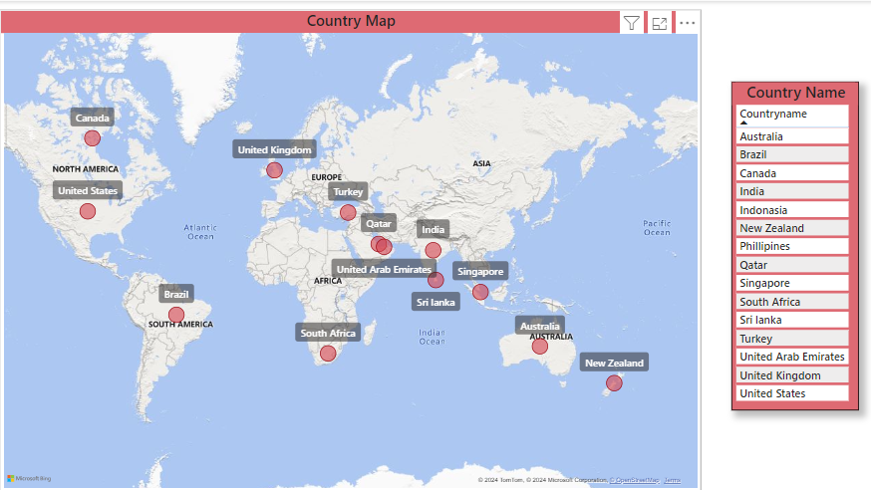
KPI_1: Country Map
Insights :
By analyzing the Country Map Table, Zomato can make strategic decisions on where to invest, which services to promote, and how to grow its global footprint.

Slide 11
KPI_3: Find the Numbers of Restaurants based on City
Insights:
Identify cities and countries with the highest concentration of restaurants. This can show key operational regions for Zomato. Countries with fewer restaurants can be identified as potential expansion opportunities

Slide 12
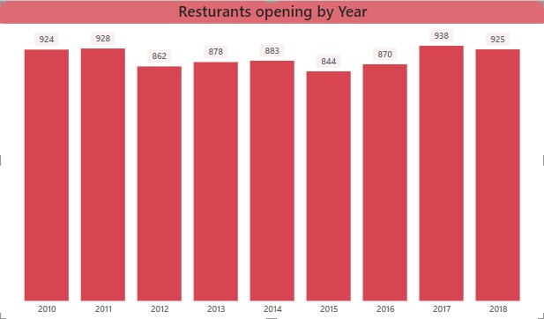
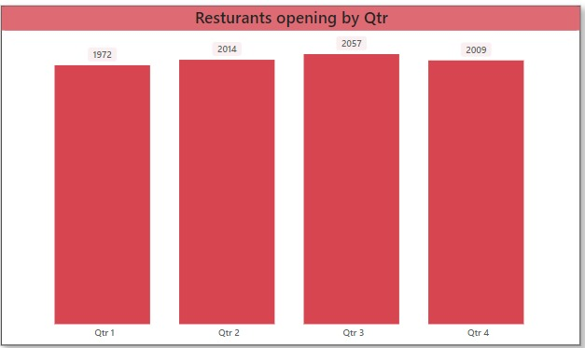
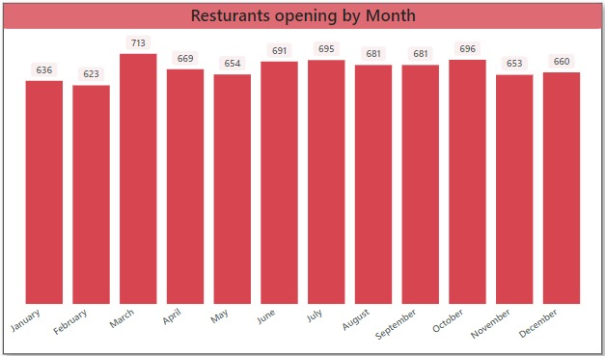
KPI_4: Numbers of Restaurants opening based on Year , Quarter , Month
Insights:
Highlight periods of growth or slowdowns in new restaurant listings. This can reveal expansion trends.

Slide 13
KPI_5 : Count of Restaurants based on Average Ratings
Insights:
Identify how well restaurants are rated on average. This can guide Zomato's focus on quality control or customer experience improvement.

Slide 14
KPI_6: Buckets based on Average Price
Insights:
This will help identify how many restaurants target different price segments, and Zomato can use this data for market positioning.

Slide 15
KPI_7. Percentage of Restaurants based on "Has_Table_booking"
Insights:
This will help understand how many restaurants are equipped to handle online table reservations and whether there's an opportunity to expand this feature.

Slide 16
KPI_8.Percentage of Restaurants based on "Has_Online_delivery"
Insights:
This can reveal market readiness for delivery and help Zomato improve its partnerships with restaurants to expand delivery services.

Slide 17
KPI_9: Develop Charts based on Cuisines
Insights:
These charts will reveal customer preferences highlight which cuisines are more popular or highly rated. This can guide marketing and operational decisions.

Slide 18
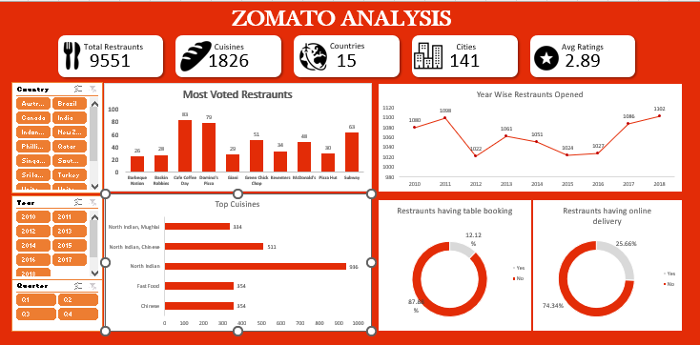
Excel Dashboard

Slide 19
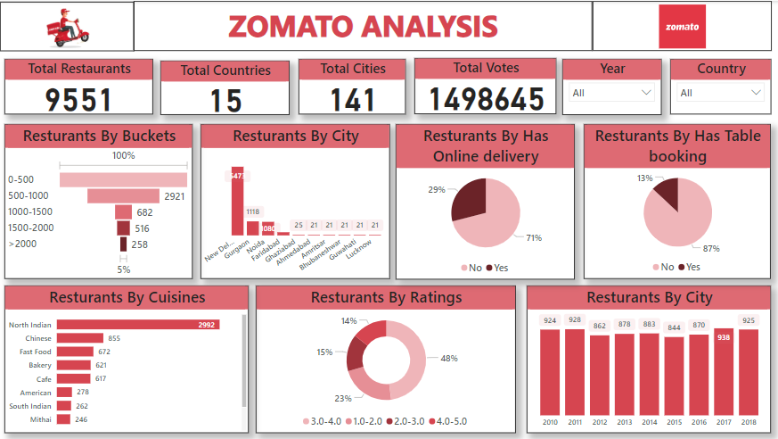
Power Bi Dashboard

Slide 20
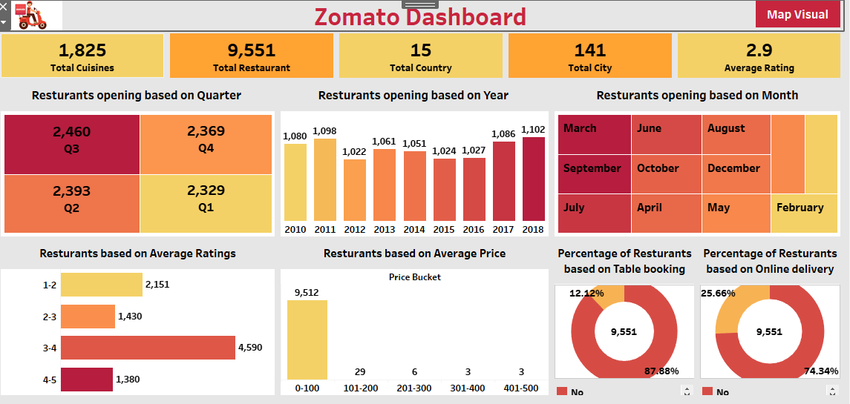
Tableau Dashboard

Slide 21
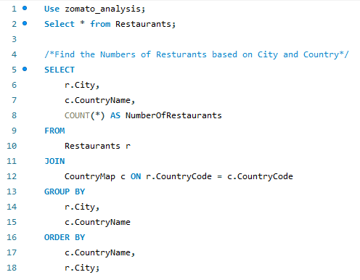
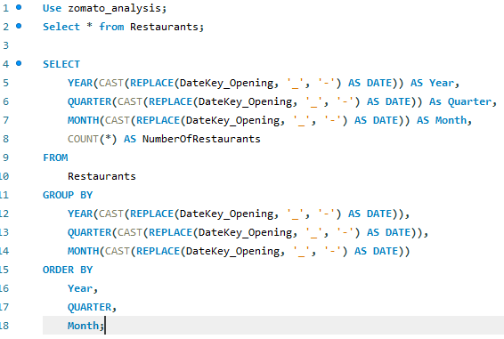
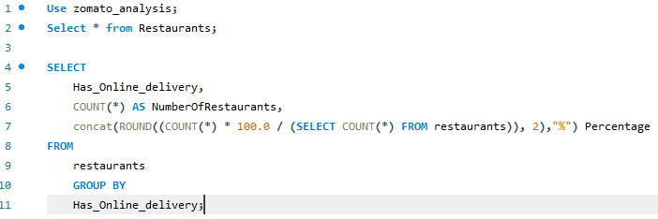
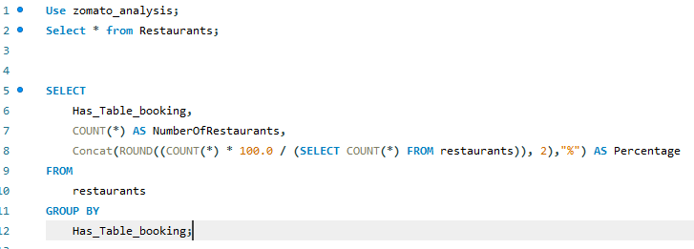
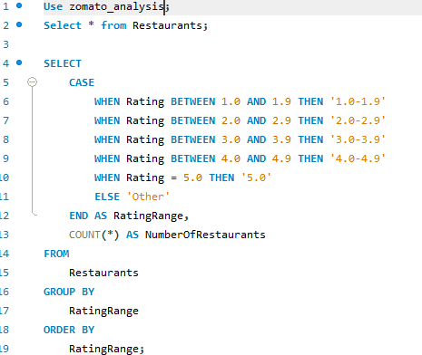
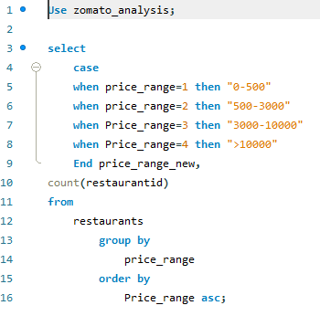
SQL Queries for Zomato Analysis

Slide 22
Recommendations & Insights
This analysis of Zomato data provided key insights into restaurant performance, customer preferences, and market trends, which can help Zomato make more informed business decisions. Here are the main takeaways:
Restaurant Distribution by City and Country:
The analysis revealed that major cities like Mumbai, Delhi, and Bangalore host a large number of restaurants. Zomato's presence in these regions is strong, and the data shows that expansion opportunities still exist in smaller cities and countries with fewer listings.
Restaurant Openings Over Time:
The time-based analysis indicated significant growth in restaurant listings during specific periods, especially around 2018-2020. Identifying these trends can help Zomato forecast future growth and identify optimal times to partner with new restaurants.
Ratings Distribution:
Most restaurants are clustered around average ratings, with fewer restaurants having extremely high or low ratings. Zomato can use this data to focus on improving the customer experience in restaurants with lower ratings through enhanced restaurant partnerships, quality checks, or better service.

Slide 23
Recommendations & Insights
Price Segmentation:
Restaurants were distributed across various price ranges, with the majority catering to mid-range dining. However, a gap was noticed in premium-priced restaurants in certain regions, which presents an opportunity for Zomato to onboard more upscale restaurants and capture a larger segment of high-income customers.
Online Delivery and Table Booking Services:
The analysis showed that a high percentage of restaurants offer online delivery, underscoring Zomato’s strong delivery service infrastructure. However, fewer restaurants provide table booking options, indicating a growth opportunity for Zomato to expand its table reservation services, especially in urban areas with high foot traffic.
Cuisine Trends:
Popular cuisines like Indian, Chinese, and Italian dominate the listings, while lesser-known or niche cuisines are underrepresented. This provides insight into customer demand and highlights areas for Zomato to either diversify its offerings or capitalize on trending cuisines.

Slide 24
Future Outlooks
Area of Exploration | Details
Customer Loyalty Programs | - Develop loyalty programs by analyzing customer behavior and spending habits. - Improve retention and drive repeat business.
Operational Efficiencies in Delivery | - Analyze delivery times to identify bottlenecks. - Optimize driver allocation and restaurant processes to ensure faster deliveries.
Personalized Marketing Campaigns | - Use customer data for targeted marketing (e.g., favorite cuisines, new local restaurants).
Restaurant Performance Monitoring | - Build real-time feedback systems for restaurants to enhance quality and improve customer experience.
Expansion of Cloud Kitchens | - Explore delivery-only kitchens (cloud kitchens) to meet rising online delivery demand cost-effectively.
Customer Segmentation & Behavior | - Segment customers based on behavior (frequent users, high spenders) to provide more customized offerings.
Sustainability Initiatives | - Analyze data to reduce food waste and promote eco-friendly packaging, aligning with customer values on sustainability.

Slide 25
Conclusion
The Zomato analysis provided valuable insights to restaurant performance, customer preferences, and market trends.
Key findings include strong restaurant presence in major cities, growth in online delivery services, and opportunities for premium-priced and niche cuisine restaurants.
Further exploration can help Zomato optimize delivery times, expand table booking services, and develop personalized marketing and loyalty programs.
By leveraging these insights, Zomato can enhance the customer experience, expand its market presence, and drive business growth.

Slide 26


